Slide 1


Preparing Data for Forecasting
Wake Forest
School of Business
_______
Forecasting

Slide 2
Basic Steps in a Forecasting Task
Problem definition
Gathering data
Preliminary (exploratory) analysis
Choosing and fitting models
Using and evaluating a forecasting model

Slide 3
Time Series Characteristics
Time series data are collected over time, but they must be made equally spaced, or indexed, before time series models can be used to quantify the systematic variation contained in it.
Accumulation is the process of indexing or transforming transactional data into a time series.
Time-stamped Data
Accumulation
Indexed Time Series Data
Missing Value Zero Value Interpretation
Analysis Ready Time Series Data

Slide 4
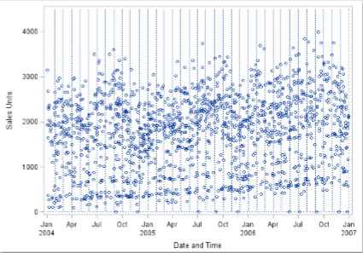
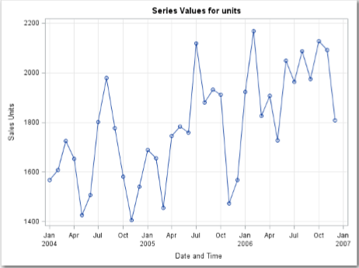
Transactional Data: Time Binning

Slide 5
Missing Values
Missing values should be represented in the data.
Date | Value
Jan66 | 13
Feb66 | 15
Apr66 | 18
Date | Value
Jan66 | 13
Feb66 | 15
Mar66 | .
Apr66 | 18

Slide 6
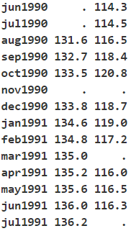
Missing Values
Embedded missing values are missing values at the beginning or end of the series. These values can be imputed, or the series can be trimmed to remove those values.
Missing values can be imputed by forecasting the missing values, using the mean, median, min, or max value, or using the previous or next value.

